Slide 1

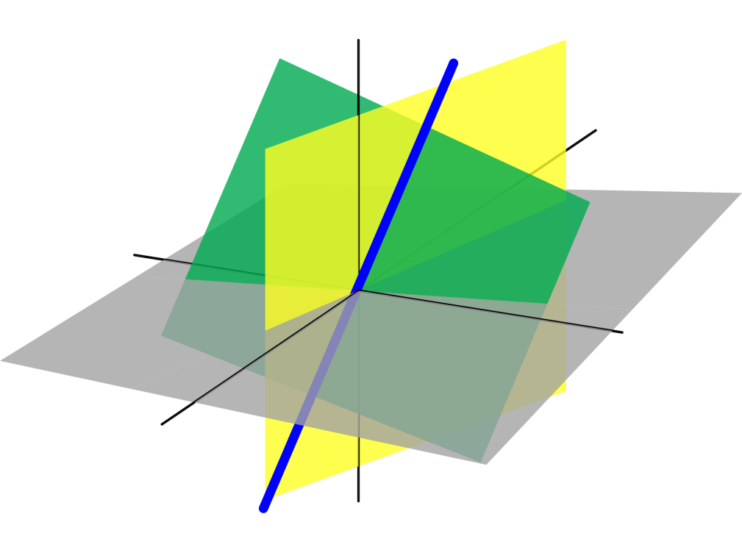
Azərbaycan Dövlət Neft və Sənaye Universiteti
Linear Algebra

Slide 2
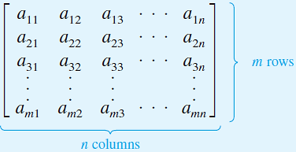
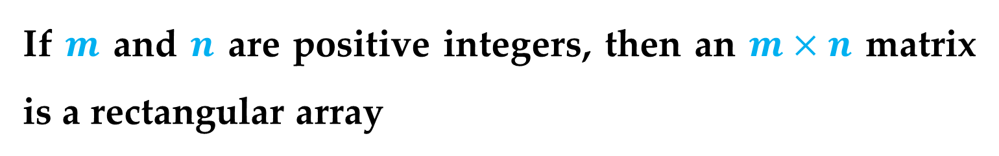
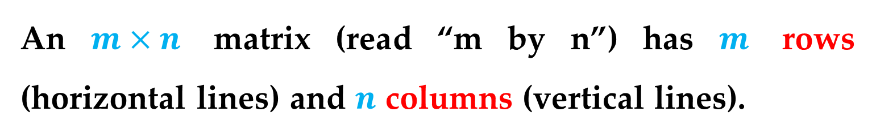
Definition of a Matrix
If $m$ and $n$ are positive integers, then an $m×n$ matrix is a rectangular array
in which each entry $a_{ij}$ of the matrix is a number.
An $m×n$ matrix (read “m by n”) has $m$ rows (horizontal lines) and $n$ columns (vertical lines).
Introduction to Matrices

Slide 3
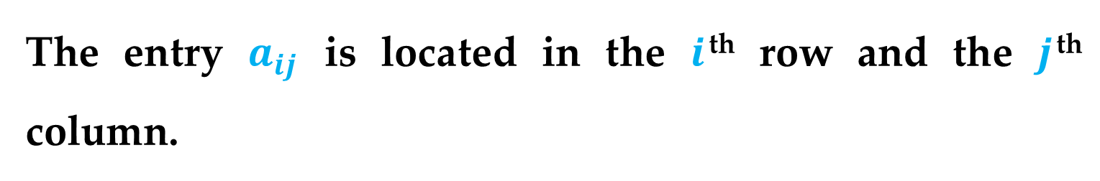
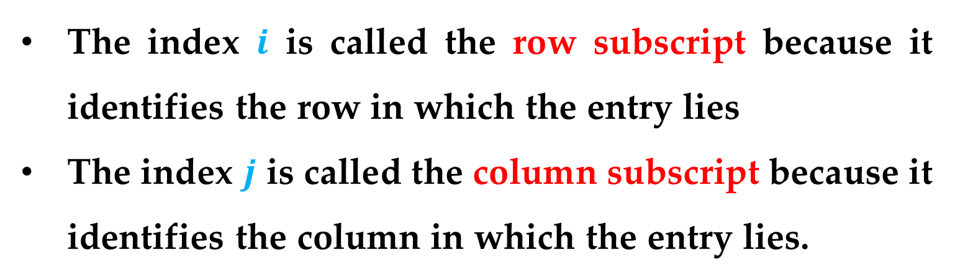
Definitions
If each entry of a matrix is a real number, then the matrix is called a real matrix.
The entry $a_{ij}$ is located in the $i$^{th} row and the $j$^{th} column.
The index $i$ is called the row subscript because it identifies the row in which the entry lies
The index $j$ is called the column subscript because it identifies the column in which the entry lies.
Introduction to Matrices

Slide 4
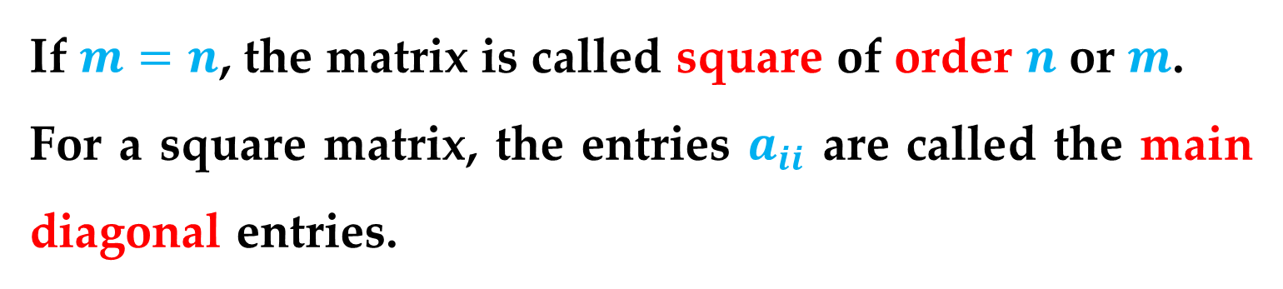
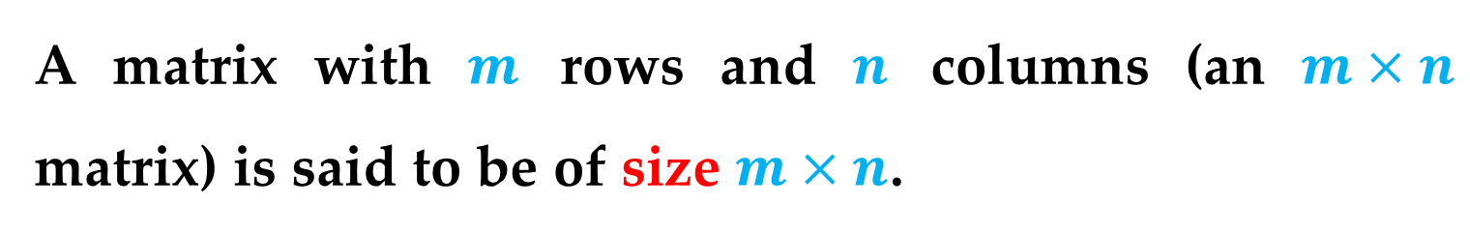
Definitions
A matrix with $m$ rows and $n$ columns (an $m×n$ matrix) is said to be of size $m×n$.
If $m=n$, the matrix is called square of order $n$ or $m$.
For a square matrix, the entries $a_{ii}$ are called the main diagonal entries.
Introduction to Matrices

Slide 5
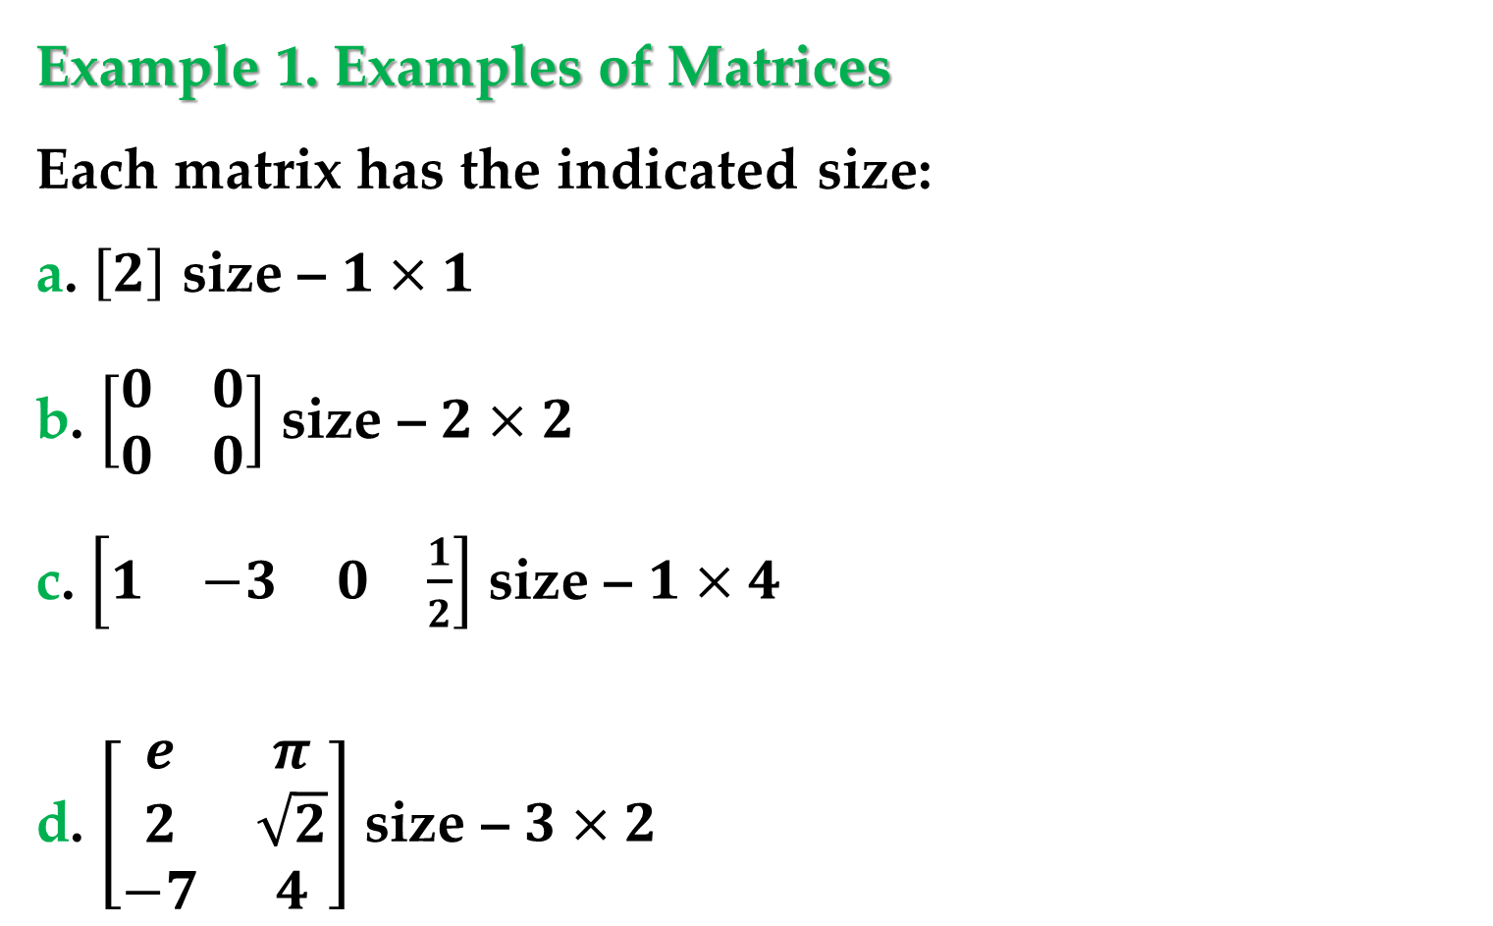
Example 1. Examples of Matrices
Each matrix has the indicated size:
a. $\left[2\right]$ size – $1×1$
b. $\left[\begin{matrix}0 & 0 \\ 0 & 0\end{matrix}\right]$ size – $2×2$
c. $\left[\begin{matrix}1 & −3 & \begin{matrix}0 & \frac{1}{2}\end{matrix}\end{matrix}\right]$ size – $1×4$
d. $\left[\begin{matrix}e & π \\ 2 & \sqrt{2} \\ −7 & 4\end{matrix}\right]$ size – $3×2$
Introduction to Matrices

Slide 6
One very common use of matrices is to represent systems of linear equations.
Definition
The matrix derived from the coefficients and constant terms of a system of linear equations is called the augmented matrix of the system.
Definition
The matrix containing only the coefficients of the system is called the coefficient matrix of the system.
Introduction to Matrices

Slide 7

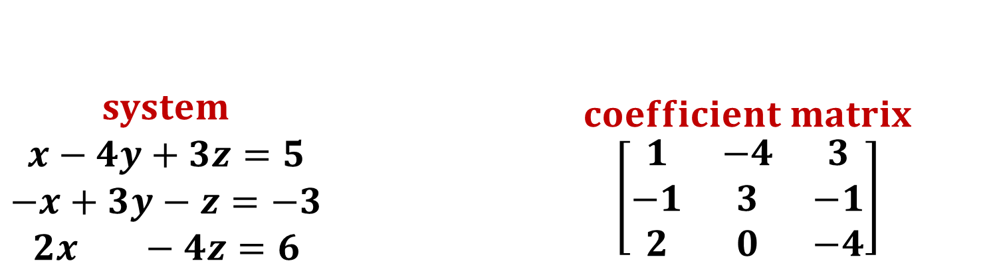
Example
$\begin{matrix}system \\ \begin{aligned}x−4y+3z=5 \\ −x+3y−z=−3 \\ 2x −4z=6\end{aligned}\end{matrix}$ $\begin{matrix}coefficient matrix \\ \left[\begin{matrix}1 & −4 & 3 \\ −1 & 3 & −1 \\ 2 & 0 & −4\end{matrix}\right]\end{matrix}$
$$\begin{matrix}augmented matrix \\ \left[\begin{matrix}\begin{matrix}1 & −4 & 3 \\ −1 & 3 & −1 \\ 2 & 0 & −4\end{matrix} & \begin{matrix}5 \\ −3 \\ 6\end{matrix}\end{matrix}\right]\end{matrix}$$

Slide 8
Definition
There are three operations that can be used on a system of linear equations to produce equivalent systems:
1. Interchange two equations.
2. Multiply an equation by a nonzero constant.
3. Add a multiple of an equation to another equation.
In matrix terminology these three operations correspond to elementary row operations.
Elementary Row Operations

Slide 9
Definition
Two matrices are said to be row-equivalent if one can be obtained from the other by a finite sequence of elementary row operations.
Elementary Row Operations
1. Interchange two rows.
2. Multiply a row by a nonzero constant.
3. Add a multiple of a row to another row.
Elementary Row Operations

Slide 10
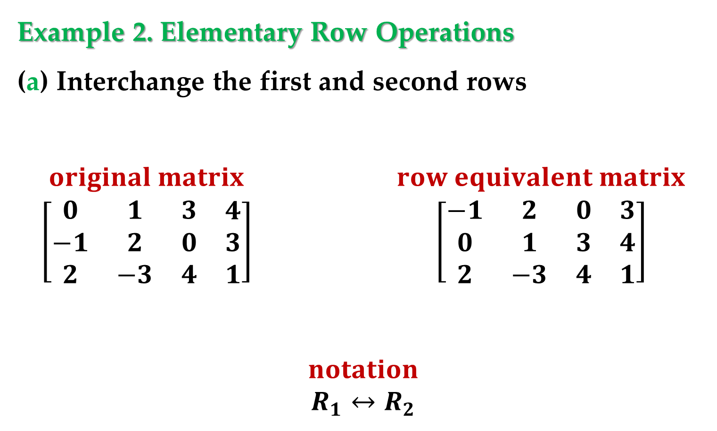
Example 2. Elementary Row Operations
(a) Interchange the first and second rows
$$\begin{matrix}original matrix \\ \left[\begin{matrix}\begin{matrix}0 & 1 & 3 \\ −1 & 2 & 0 \\ 2 & −3 & 4\end{matrix} & \begin{matrix}4 \\ 3 \\ 1\end{matrix}\end{matrix}\right]\end{matrix} \begin{matrix}row equivalent matrix \\ \left[\begin{matrix}\begin{matrix}−1 & 2 & 0 \\ 0 & 1 & 3 \\ 2 & −3 & 4\end{matrix} & \begin{matrix}3 \\ 4 \\ 1\end{matrix}\end{matrix}\right]\end{matrix}$$
$$\begin{matrix}notation \\ R_{1}↔R_{2}\end{matrix}$$
Elementary Row Operations

Slide 11
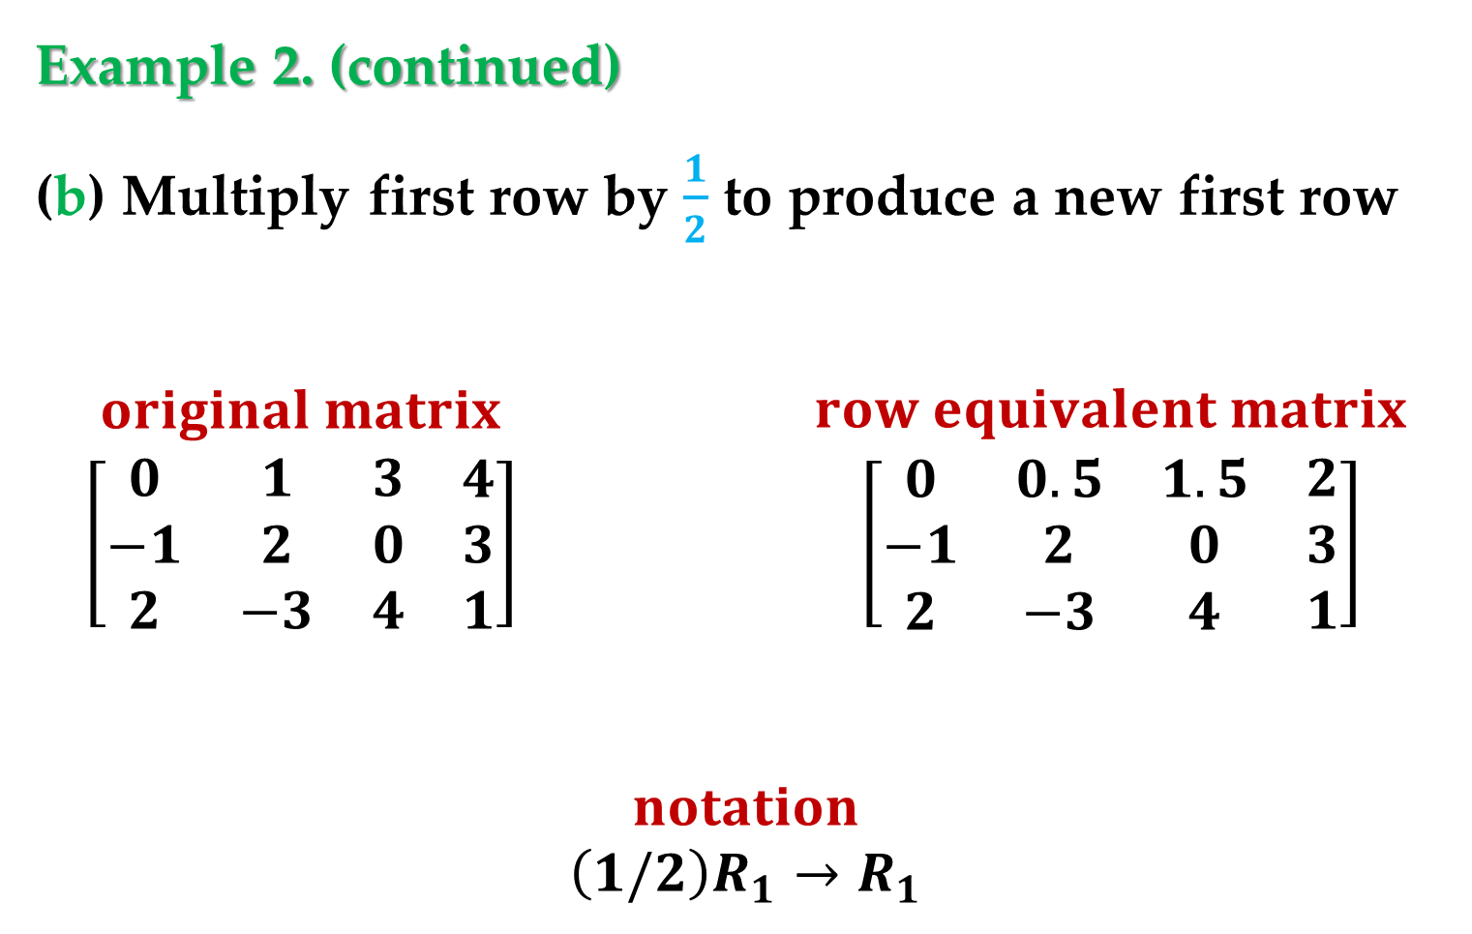
Example 2. (continued)
(b) Multiply first row by $\frac{1}{2}$ to produce a new first row
$$\begin{matrix}original matrix \\ \left[\begin{matrix}\begin{matrix}0 & 1 & 3 \\ −1 & 2 & 0 \\ 2 & −3 & 4\end{matrix} & \begin{matrix}4 \\ 3 \\ 1\end{matrix}\end{matrix}\right]\end{matrix} \begin{matrix}row equivalent matrix \\ \left[\begin{matrix}\begin{matrix}0 & 0.5 & 1.5 \\ −1 & 2 & 0 \\ 2 & −3 & 4\end{matrix} & \begin{matrix}2 \\ 3 \\ 1\end{matrix}\end{matrix}\right]\end{matrix}$$
$$\begin{matrix}notation \\ {\left(1/2\right)R}_{1}→R_{1}\end{matrix}$$
Elementary Row Operations

Slide 12
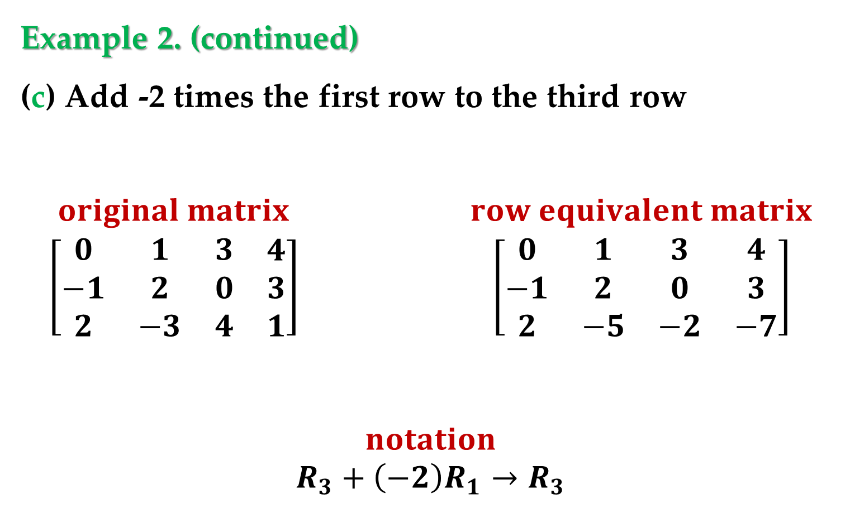
Example 2. (continued)
(c) Add -2 times the first row to the third row
$$\begin{matrix}original matrix \\ \left[\begin{matrix}\begin{matrix}0 & 1 & 3 \\ −1 & 2 & 0 \\ 2 & −3 & 4\end{matrix} & \begin{matrix}4 \\ 3 \\ 1\end{matrix}\end{matrix}\right]\end{matrix} \begin{matrix}row equivalent matrix \\ \left[\begin{matrix}\begin{matrix}0 & 1 & 3 \\ −1 & 2 & 0 \\ 2 & −5 & −2\end{matrix} & \begin{matrix}4 \\ 3 \\ −7\end{matrix}\end{matrix}\right]\end{matrix}$$
$$\begin{matrix}notation \\ R_{3}+{\left(−2\right)R}_{1}→R_{3}\end{matrix}$$
Elementary Row Operations

Slide 13
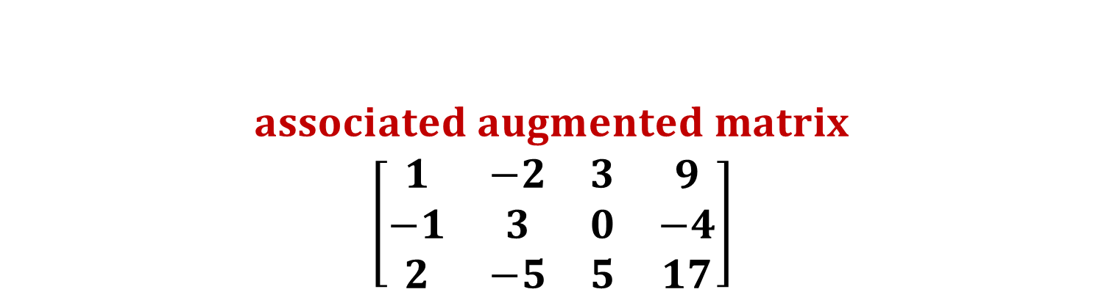
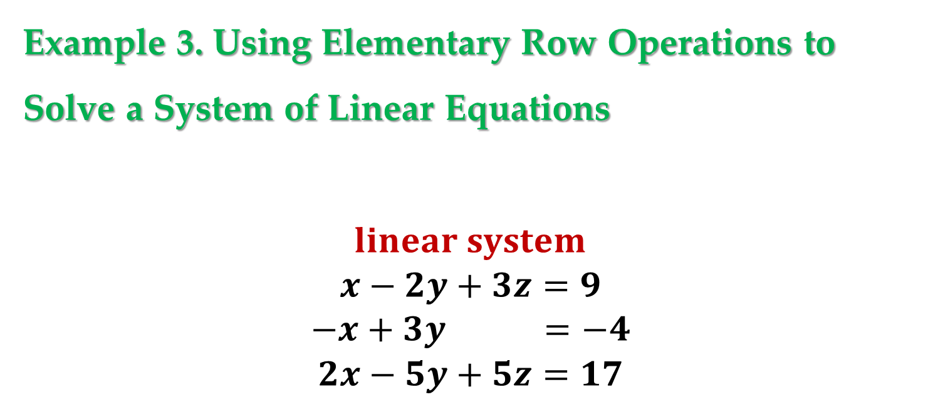
Example 3. Using Elementary Row Operations to Solve a System of Linear Equations
$$\begin{matrix}linear system \\ \begin{aligned}\begin{aligned}x−2y+3z=9 \\ −x+3y =−4\end{aligned} \\ 2x−5y+5z=17\end{aligned}\end{matrix}$$
$$\begin{matrix}associated augmented matrix \\ \left[\begin{matrix}\begin{matrix}1 & −2 & 3 \\ −1 & 3 & 0 \\ 2 & −5 & 5\end{matrix} & \begin{matrix}9 \\ −4 \\ 17\end{matrix}\end{matrix}\right]\end{matrix}$$

Slide 14
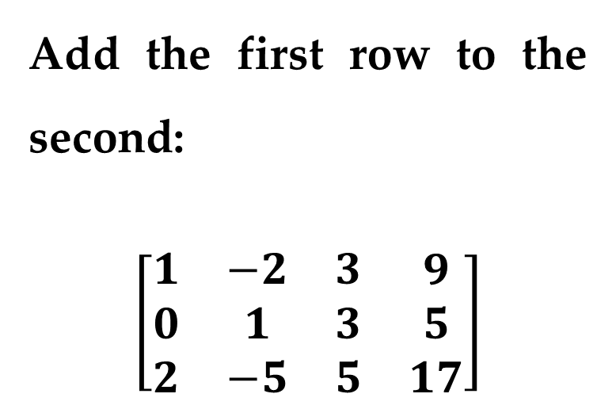
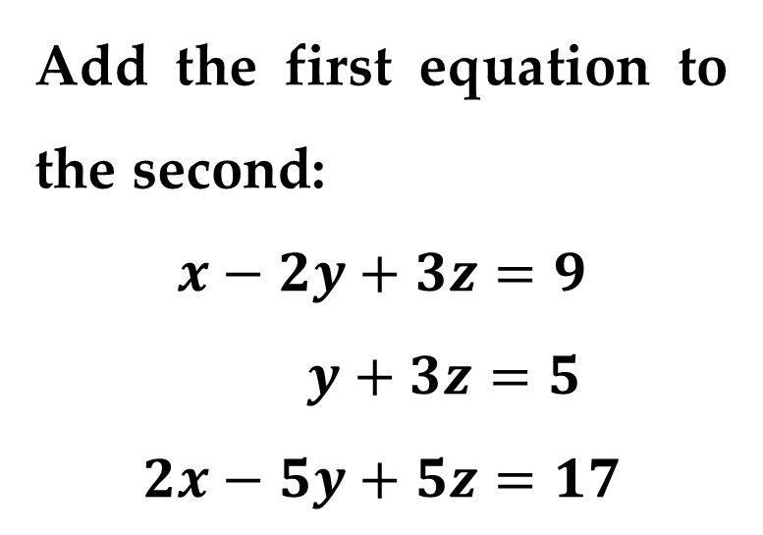
Example 3. (continued)
Add the first equation to the second:
$$x−2y+3z=9$$
$y+3z=5$
$$2x−5y+5z=17$$
Add the first row to the second:
$$\left[\begin{matrix}\begin{matrix}1 & −2 & 3 \\ 0 & 1 & 3 \\ 2 & −5 & 5\end{matrix} & \begin{matrix}9 \\ 5 \\ 17\end{matrix}\end{matrix}\right]$$
Elementary Row Operations

Slide 15
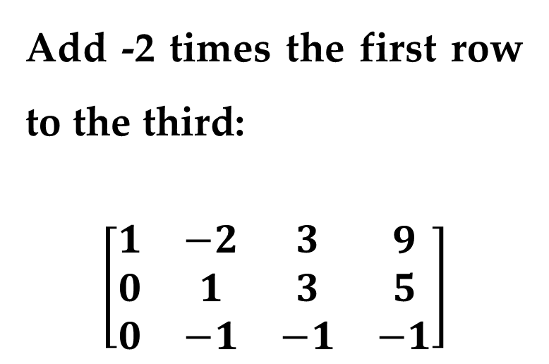
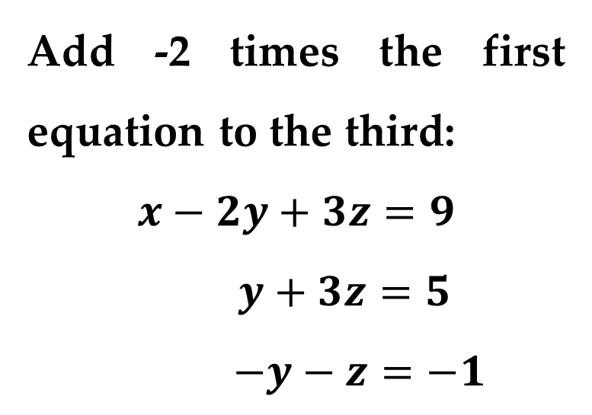
Example 3. (continued)
Add -2 times the first equation to the third:
$$x−2y+3z=9$$
$y+3z=5$
$$−y−z=−1$$
Add -2 times the first row to the third:
$$\left[\begin{matrix}\begin{matrix}1 & −2 & 3 \\ 0 & 1 & 3 \\ 0 & −1 & −1\end{matrix} & \begin{matrix}9 \\ 5 \\ −1\end{matrix}\end{matrix}\right]$$
Elementary Row Operations

Slide 16
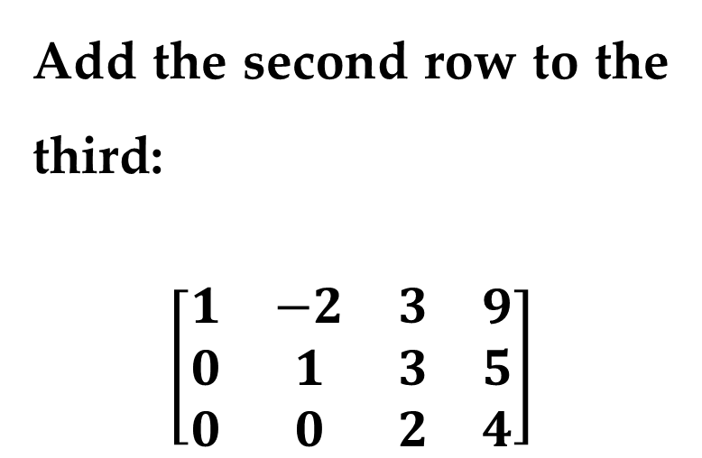
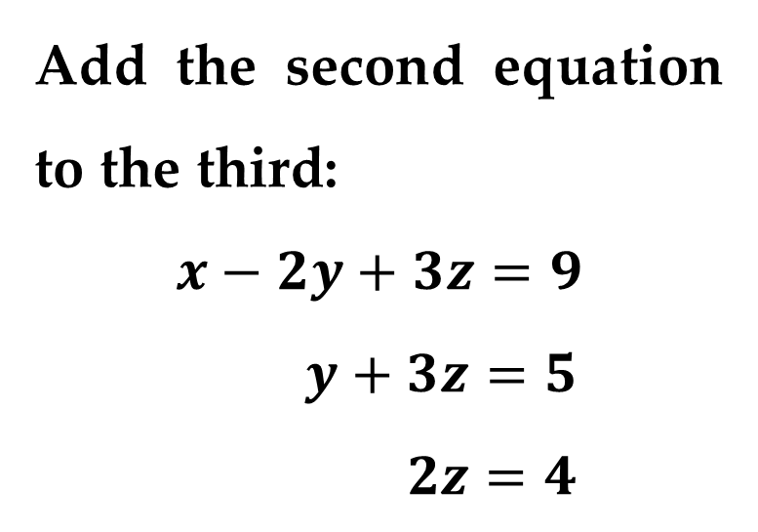
Example 3. (continued)
Add the second equation to the third:
$$x−2y+3z=9$$
$y+3z=5$
$$2z=4$$
Add the second row to the third:
$$\left[\begin{matrix}\begin{matrix}1 & −2 & 3 \\ 0 & 1 & 3 \\ 0 & 0 & 2\end{matrix} & \begin{matrix}9 \\ 5 \\ 4\end{matrix}\end{matrix}\right]$$
Elementary Row Operations

Slide 17
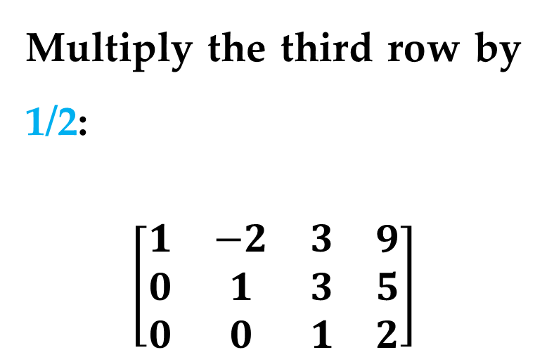
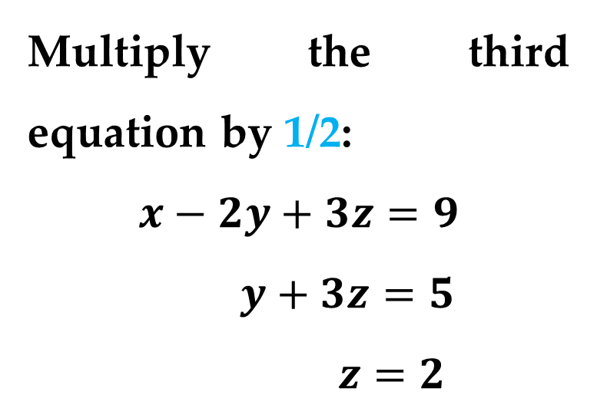
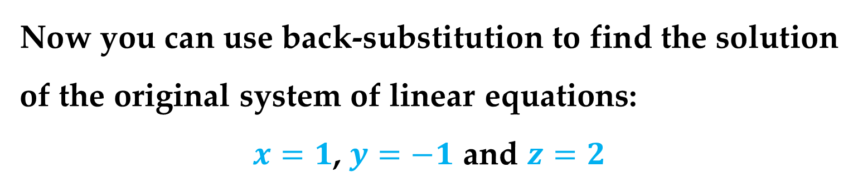
Example 3. (continued)
Multiply the third equation by 1/2:
$$x−2y+3z=9$$
$y+3z=5$
$$z=2$$
Multiply the third row by 1/2:
$$\left[\begin{matrix}\begin{matrix}1 & −2 & 3 \\ 0 & 1 & 3 \\ 0 & 0 & 1\end{matrix} & \begin{matrix}9 \\ 5 \\ 2\end{matrix}\end{matrix}\right]$$
Now you can use back-substitution to find the solution of the original system of linear equations:
$x=1$, $y=−1$ and $z=2$
Elementary Row Operations

Slide 18
Definition
The last matrix in this Example is said to be in row-echelon form.
The term “echelon” refers to the stair-step pattern formed by the nonzero elements of the matrix.
To be in row-echelon form, a matrix must have the properties listed below.
Elementary Row Operations

Slide 19
Properties of Row-Echelon Form of a Matrix
1. All rows consisting entirely of zeros occur at the bottom of the matrix.
2. For each row that does not consist entirely of zeros, the first nonzero entry is 1 (called a leading 1).
3. For two successive (nonzero) rows, the leading 1 in the higher row is farther to the left than the leading 1 in the lower row.
Elementary Row Operations

Slide 20
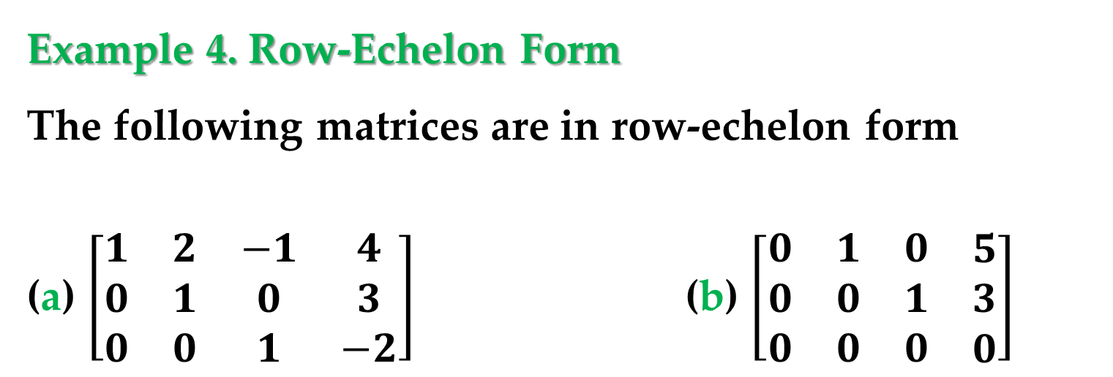
Definition
A matrix in row-echelon form is in reduced row-echelon form if every column that has a leading 1 has zeros in every position above and below its leading 1.
Example 4. Row-Echelon Form
The following matrices are in row-echelon form
(a) $\left[\begin{matrix}\begin{matrix}1 & 2 & −1 \\ 0 & 1 & 0 \\ 0 & 0 & 1\end{matrix} & \begin{matrix}4 \\ 3 \\ −2\end{matrix}\end{matrix}\right]$ (b) $\left[\begin{matrix}\begin{matrix}0 & 1 & 0 \\ 0 & 0 & 1 \\ 0 & 0 & 0\end{matrix} & \begin{matrix}5 \\ 3 \\ 0\end{matrix}\end{matrix}\right]$
Gaussian Elimination

Slide 21
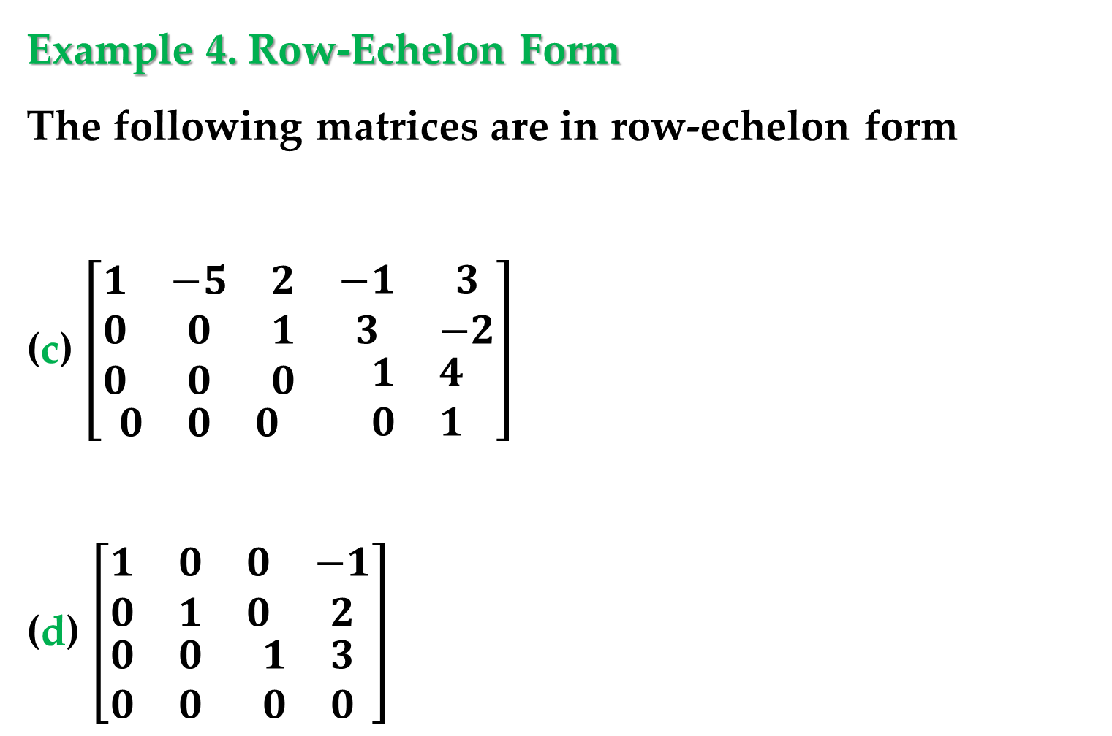
Example 4. Row-Echelon Form
The following matrices are in row-echelon form
(c) $\left[\begin{matrix}\begin{matrix}\begin{matrix}1 & −5 & 2 \\ 0 & 0 & 1 \\ 0 & 0 & 0\end{matrix} \\ \begin{matrix}0 & 0 & 0\end{matrix}\end{matrix} & \begin{matrix}\begin{matrix}−1 & 3 \\ 3 & −2\end{matrix} \\ \begin{matrix}1 & 4 \\ 0 & 1\end{matrix}\end{matrix}\end{matrix}\right]$
(d) $\left[\begin{matrix}\begin{matrix}1 & 0 \\ 0 & 1\end{matrix} & \begin{matrix}0 & −1 \\ 0 & 2\end{matrix} \\ \begin{matrix}0 & 0 \\ 0 & 0\end{matrix} & \begin{matrix}1 & 3 \\ 0 & 0\end{matrix}\end{matrix}\right]$
Gaussian Elimination

Slide 22
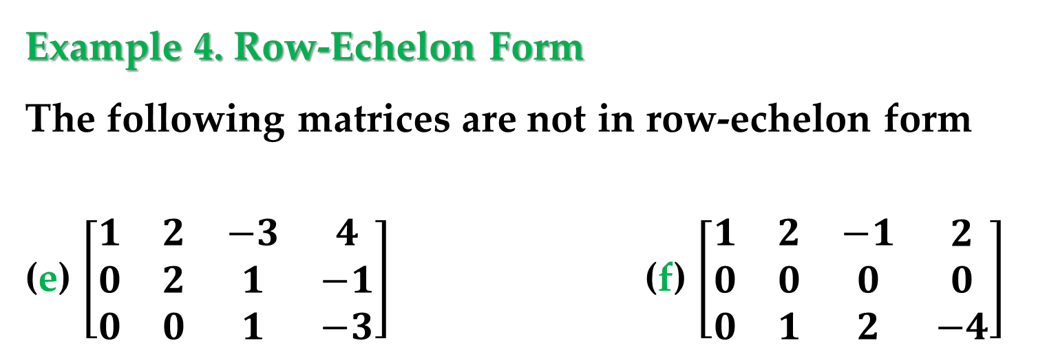
The matrices shown in parts (b) and (d) are in reduced row-echelon form.
Example 4. Row-Echelon Form
The following matrices are not in row-echelon form
(e) $\left[\begin{matrix}\begin{matrix}1 & 2 & −3 \\ 0 & 2 & 1 \\ 0 & 0 & 1\end{matrix} & \begin{matrix}4 \\ −1 \\ −3\end{matrix}\end{matrix}\right]$ (f) $\left[\begin{matrix}\begin{matrix}1 & 2 & −1 \\ 0 & 0 & 0 \\ 0 & 1 & 2\end{matrix} & \begin{matrix}2 \\ 0 \\ −4\end{matrix}\end{matrix}\right]$
It can be shown that every matrix is row-equivalent to a matrix in row-echelon form.
Gaussian Elimination

Slide 23
Gaussian Elimination with Back-Substitution
1. Write the augmented matrix of the system of linear equations.
2. Use elementary row operations to rewrite the augmented matrix in row-echelon form.
3. Write the system of linear equations corresponding to the matrix in row-echelon form, and use back-substitution to find the solution.
Gaussian Elimination

Slide 24
Remark
Gaussian elimination with back-substitution works well as an algorithmic method for solving systems of linear equations.
For this algorithm, the order in which the elementary row operations are performed is important.
Move from left to right by columns, changing all entries directly below the leading 1’s to zeros.
Gaussian Elimination

Slide 25
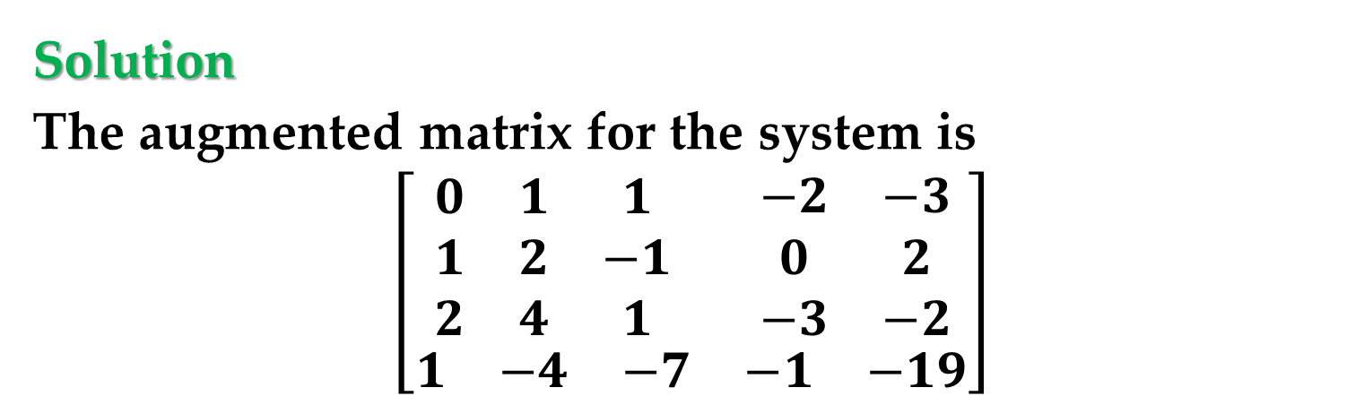
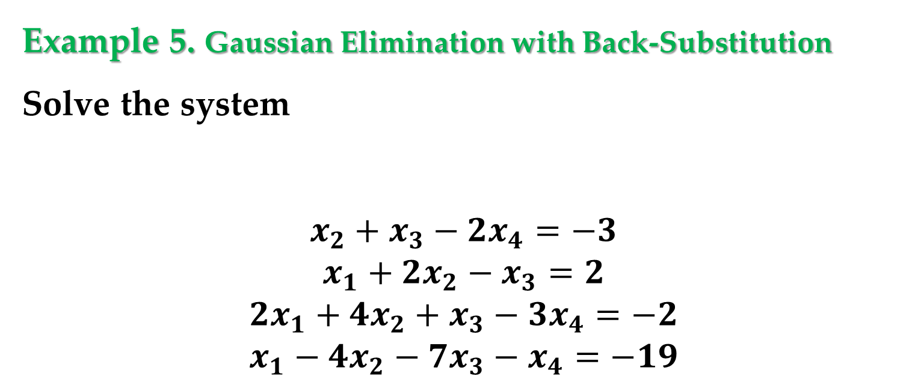
Example 5. Gaussian Elimination with Back-Substitution
Solve the system
$$\begin{matrix}x_{2}+x_{3}−2x_{4}=−3 \\ x_{1}+2x_{2}−x_{3}=2 \\ \begin{matrix}2x_{1}+4x_{2}+x_{3}−3x_{4}=−2 \\ x_{1}−4x_{2}−7x_{3}−x_{4}=−19\end{matrix}\end{matrix}$$
Solution
The augmented matrix for the system is
$$\left[\begin{matrix}\begin{matrix}\begin{matrix}0 & 1 & 1 \\ 1 & 2 & −1 \\ 2 & 4 & 1\end{matrix} \\ \begin{matrix}1 & −4 & −7\end{matrix}\end{matrix} & \begin{matrix}\begin{matrix}−2 & −3 \\ 0 & 2 \\ −3 & −2\end{matrix} \\ \begin{matrix}−1 & −19\end{matrix}\end{matrix}\end{matrix}\right]$$

Slide 26
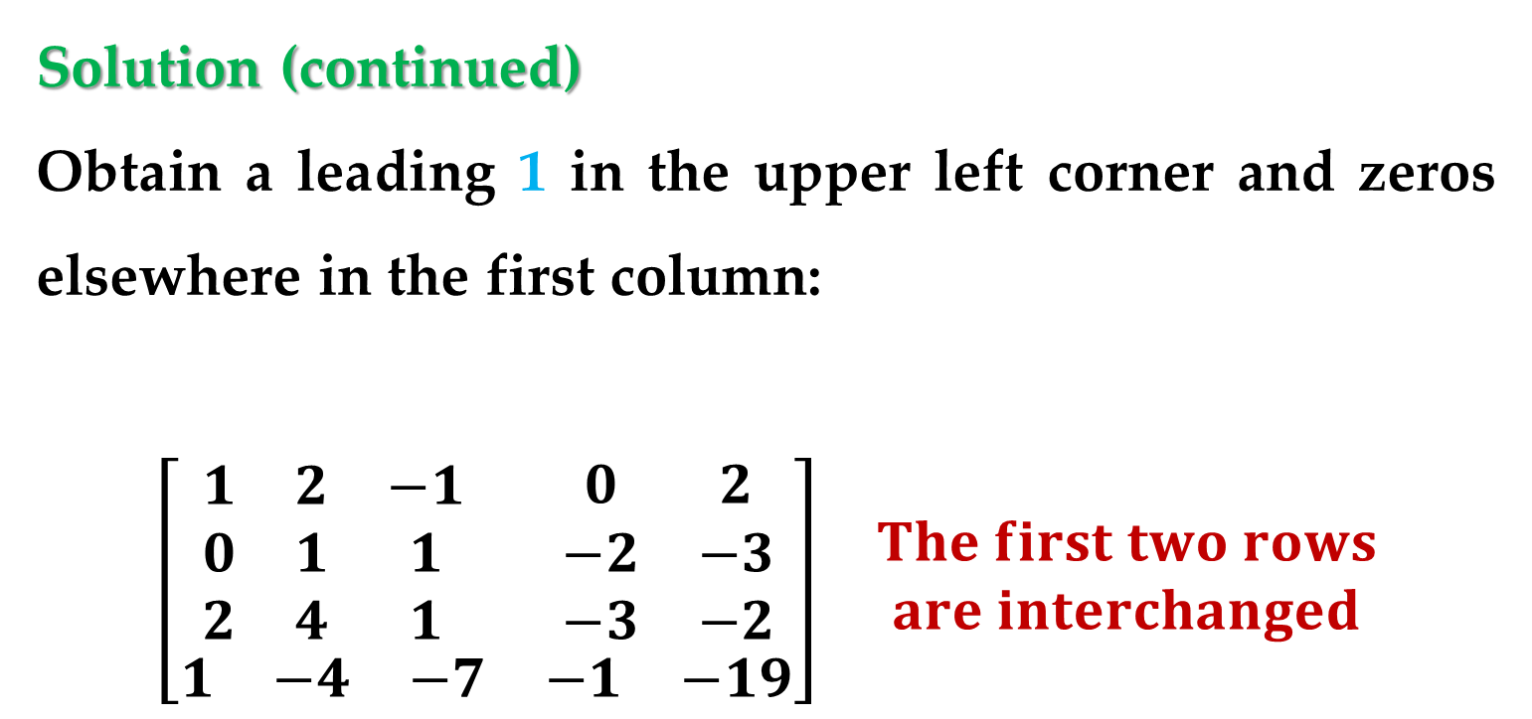
Solution (continued)
Obtain a leading 1 in the upper left corner and zeros elsewhere in the first column:
$$\begin{matrix}\left[\begin{matrix}\begin{matrix}\begin{matrix}1 & 2 & −1 \\ 0 & 1 & 1 \\ 2 & 4 & 1\end{matrix} \\ \begin{matrix}1 & −4 & −7\end{matrix}\end{matrix} & \begin{matrix}\begin{matrix}0 & 2 \\ −2 & −3 \\ −3 & −2\end{matrix} \\ \begin{matrix}−1 & −19\end{matrix}\end{matrix}\end{matrix}\right] & \begin{aligned}The first two rows \\ are interchanged\end{aligned}\end{matrix}$$
Gaussian Elimination

Slide 27
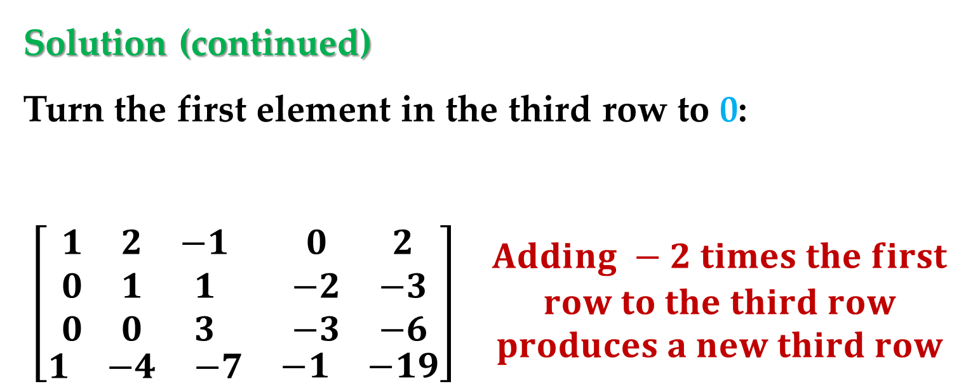
Solution (continued)
Turn the first element in the third row to 0:
$$\begin{matrix}\left[\begin{matrix}\begin{matrix}\begin{matrix}1 & 2 & −1 \\ 0 & 1 & 1 \\ 0 & 0 & 3\end{matrix} \\ \begin{matrix}1 & −4 & −7\end{matrix}\end{matrix} & \begin{matrix}\begin{matrix}0 & 2 \\ −2 & −3 \\ −3 & −6\end{matrix} \\ \begin{matrix}−1 & −19\end{matrix}\end{matrix}\end{matrix}\right] & \begin{aligned}Adding −2 times the first \\ row to the third row \\ produces a new third row\end{aligned}\end{matrix}$$
Gaussian Elimination

Slide 28
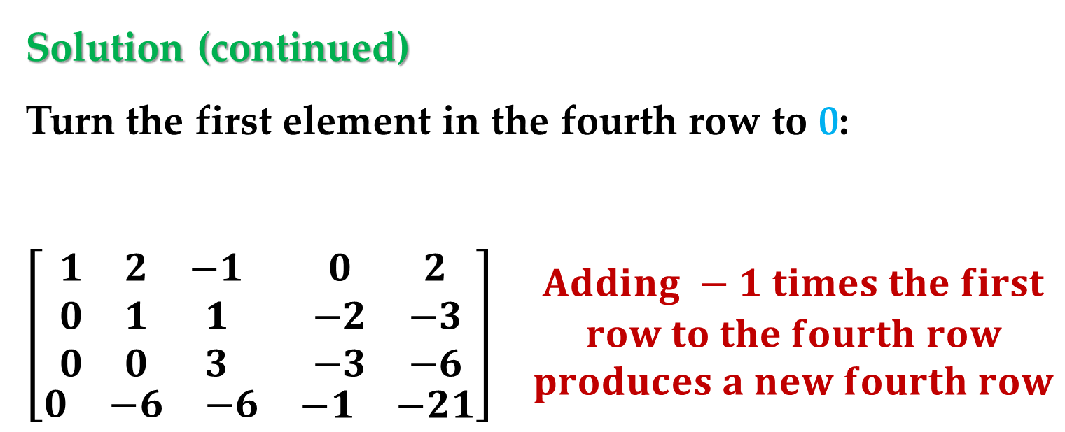
Solution (continued)
Turn the first element in the fourth row to 0:
$$\begin{matrix}\left[\begin{matrix}\begin{matrix}\begin{matrix}1 & 2 & −1 \\ 0 & 1 & 1 \\ 0 & 0 & 3\end{matrix} \\ \begin{matrix}0 & −6 & −6\end{matrix}\end{matrix} & \begin{matrix}\begin{matrix}0 & 2 \\ −2 & −3 \\ −3 & −6\end{matrix} \\ \begin{matrix}−1 & −21\end{matrix}\end{matrix}\end{matrix}\right] & \begin{aligned}Adding −1 times the first \\ row to the fourth row \\ produces a new fourth row\end{aligned}\end{matrix}$$
Gaussian Elimination

Slide 29
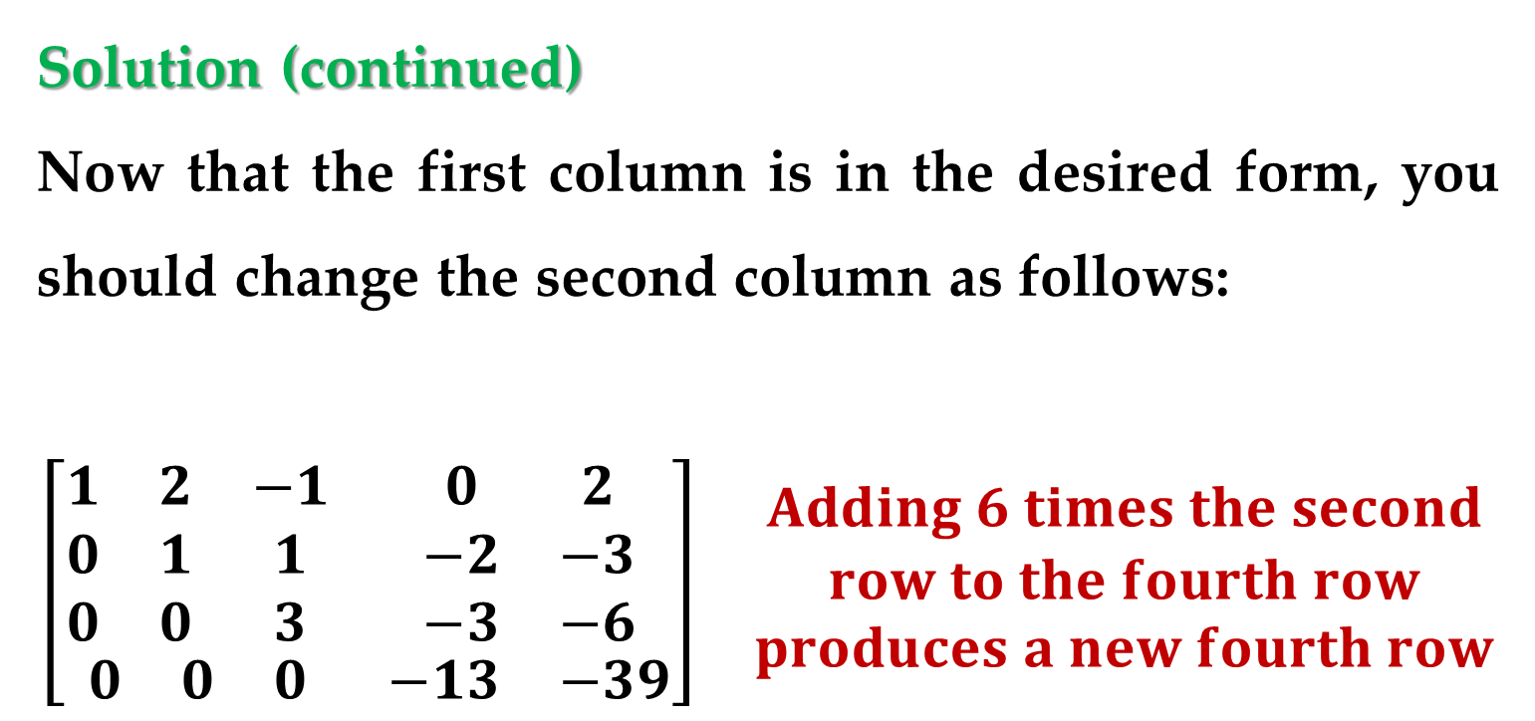
Solution (continued)
Now that the first column is in the desired form, you should change the second column as follows:
$$\begin{matrix}\left[\begin{matrix}\begin{matrix}\begin{matrix}1 & 2 & −1 \\ 0 & 1 & 1 \\ 0 & 0 & 3\end{matrix} \\ \begin{matrix}0 & 0 & 0\end{matrix}\end{matrix} & \begin{matrix}\begin{matrix}0 & 2 \\ −2 & −3 \\ −3 & −6\end{matrix} \\ \begin{matrix}−13 & −39\end{matrix}\end{matrix}\end{matrix}\right] & \begin{aligned}Adding 6 times the second \\ row to the fourth row \\ produces a new fourth row\end{aligned}\end{matrix}$$
Gaussian Elimination

Slide 30
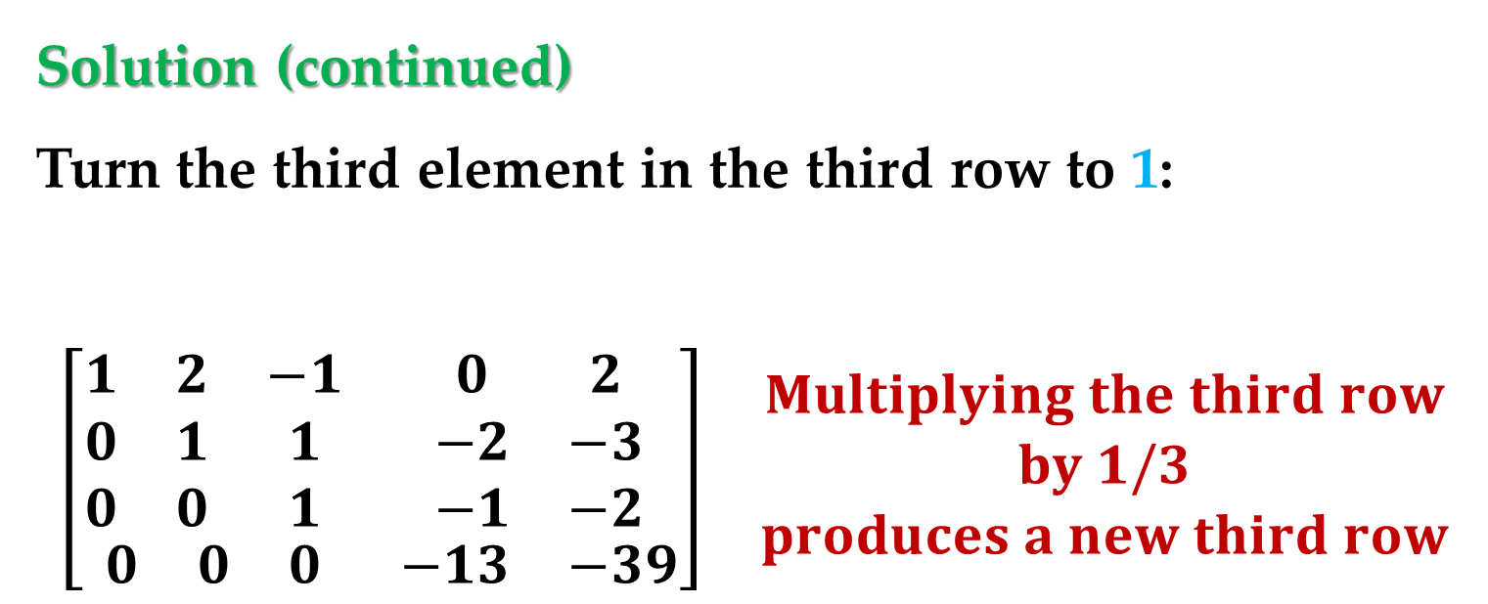
Solution (continued)
Turn the third element in the third row to 1:
$$\begin{matrix}\left[\begin{matrix}\begin{matrix}\begin{matrix}1 & 2 & −1 \\ 0 & 1 & 1 \\ 0 & 0 & 1\end{matrix} \\ \begin{matrix}0 & 0 & 0\end{matrix}\end{matrix} & \begin{matrix}\begin{matrix}0 & 2 \\ −2 & −3 \\ −1 & −2\end{matrix} \\ \begin{matrix}−13 & −39\end{matrix}\end{matrix}\end{matrix}\right] & \begin{aligned}Multiplying the third row \\ by 1/3 \\ produces a new third row\end{aligned}\end{matrix}$$
Gaussian Elimination

Slide 31
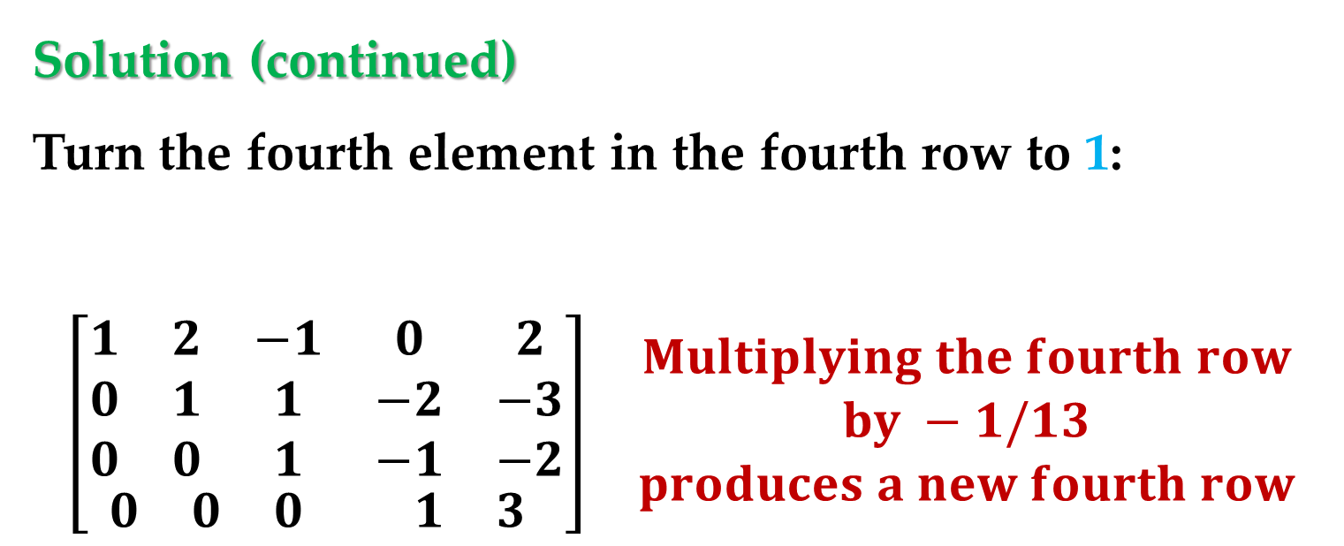
Solution (continued)
Turn the fourth element in the fourth row to 1:
$$\begin{matrix}\left[\begin{matrix}\begin{matrix}\begin{matrix}1 & 2 & −1 \\ 0 & 1 & 1 \\ 0 & 0 & 1\end{matrix} \\ \begin{matrix}0 & 0 & 0\end{matrix}\end{matrix} & \begin{matrix}\begin{matrix}0 & 2 \\ −2 & −3 \\ −1 & −2\end{matrix} \\ \begin{matrix}1 & 3\end{matrix}\end{matrix}\end{matrix}\right] & \begin{aligned}Multiplying the fourth row \\ by −1/13 \\ produces a new fourth row\end{aligned}\end{matrix}$$
Gaussian Elimination

Slide 32
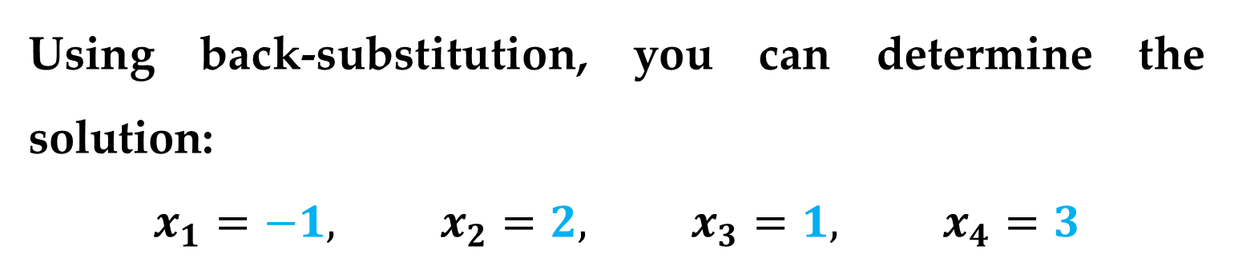
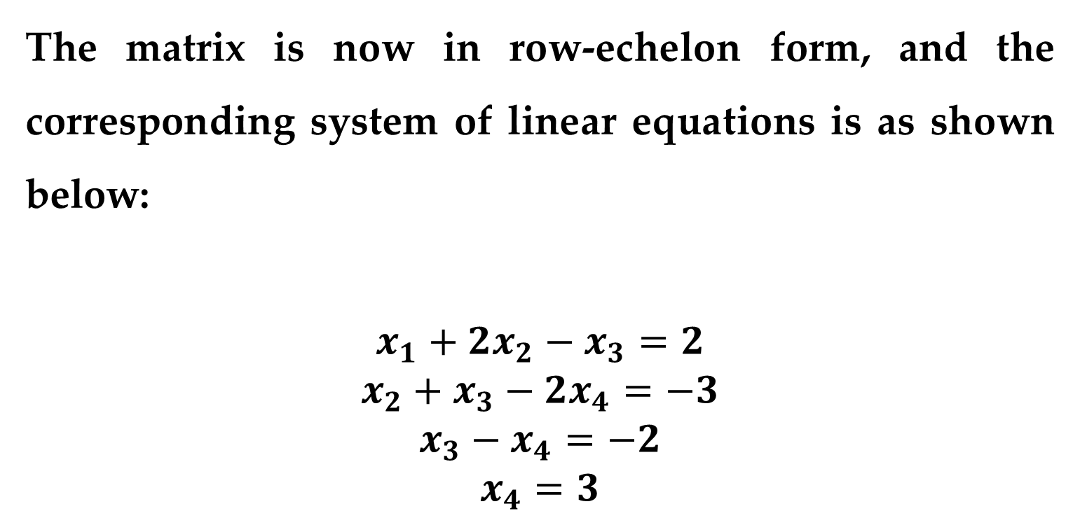
Solution (continued)
The matrix is now in row-echelon form, and the corresponding system of linear equations is as shown below:
$$\begin{matrix}x_{1}+2x_{2}−x_{3}=2 \\ x_{2}+x_{3}−2x_{4}=−3 \\ \begin{matrix}x_{3}−x_{4}=−2 \\ x_{4}=3\end{matrix}\end{matrix}$$
Using back-substitution, you can determine the solution:
$$x_{1}=−1, x_{2}=2, x_{3}=1, x_{4}=3$$

Slide 33
Remark
When solving a system of linear equations, remember that it is possible for the system to have no solution.
So, how do you ascertain the fact that the system has no solution?
If during the elimination process you obtain a row with all zeros except for the last entry, it is unnecessary to continue the elimination process – you can simply conclude that the system is inconsistent and has no solution.

Slide 34
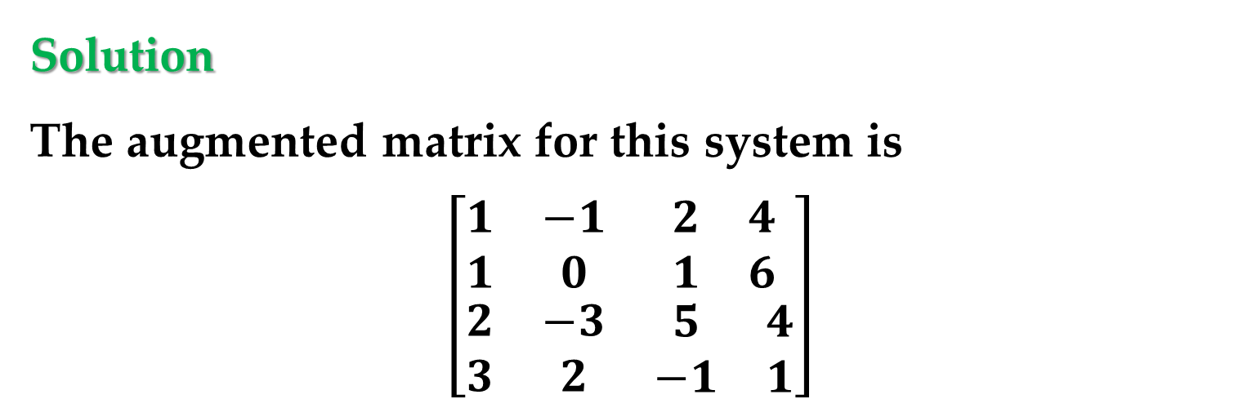

Example 5. A System with No Solution
Solve the system:
$$x_{1}−x_{2}+2x_{3}=4$$
$$x_{1}+ x_{3}=6$$
$$2x_{1}−3x_{2}+5x_{3}=4$$
$$3x_{1} +2x_{2}−x_{3}=1$$
Solution
The augmented matrix for this system is
$$\left[\begin{matrix}\begin{matrix}1 & −1 \\ 1 & 0\end{matrix} & \begin{matrix}2 & 4 \\ 1 & 6\end{matrix} \\ \begin{matrix}2 & −3 \\ 3 & 2\end{matrix} & \begin{matrix}5 & 4 \\ −1 & 1\end{matrix}\end{matrix}\right]$$

Slide 35
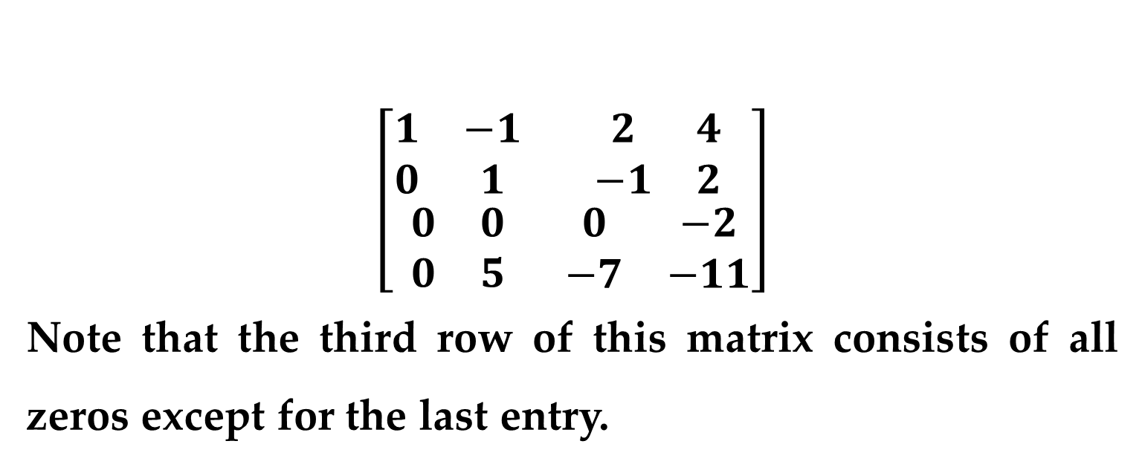
Solution (continued)
Apply Gaussian elimination procedure to the augmented matrix. ***
$$\left[\begin{matrix}\begin{matrix}1 & −1 \\ 0 & 1\end{matrix} & \begin{matrix}2 & 4 \\ −1 & 2\end{matrix} \\ \begin{matrix}0 & 0 \\ 0 & 5\end{matrix} & \begin{matrix}0 & −2 \\ −7 & −11\end{matrix}\end{matrix}\right]$$
Note that the third row of this matrix consists of all zeros except for the last entry.
This means that the original system of linear equations is inconsistent.

Slide 36
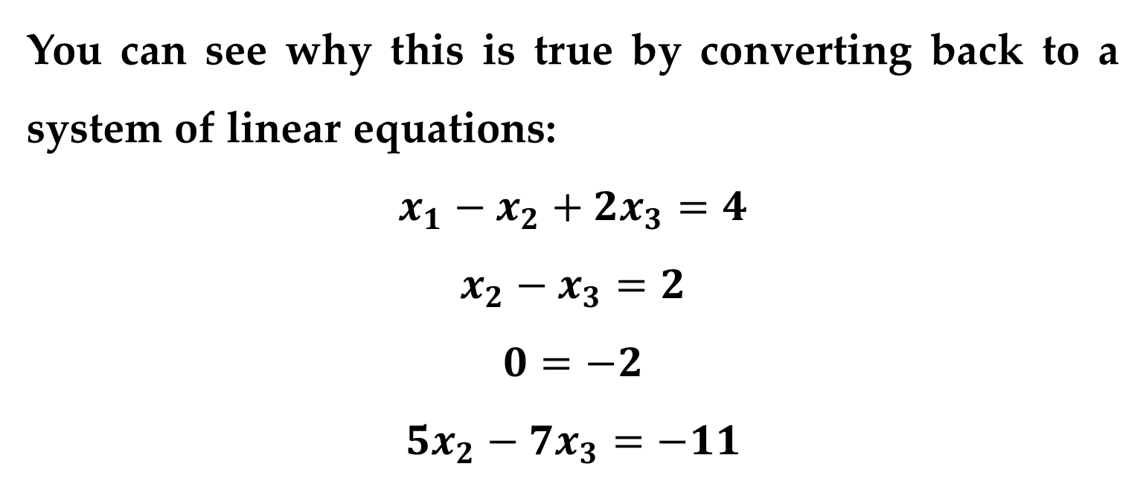
Solution (continued)
You can see why this is true by converting back to a system of linear equations:
$$x_{1}−x_{2}+2x_{3}=4$$
$$x_{2}−x_{3}=2$$
$$0=−2$$
$$5x_{2}−7x_{3}=−11$$
Because the third “equation” is a false statement, it follows that the system has no solution.

Slide 37
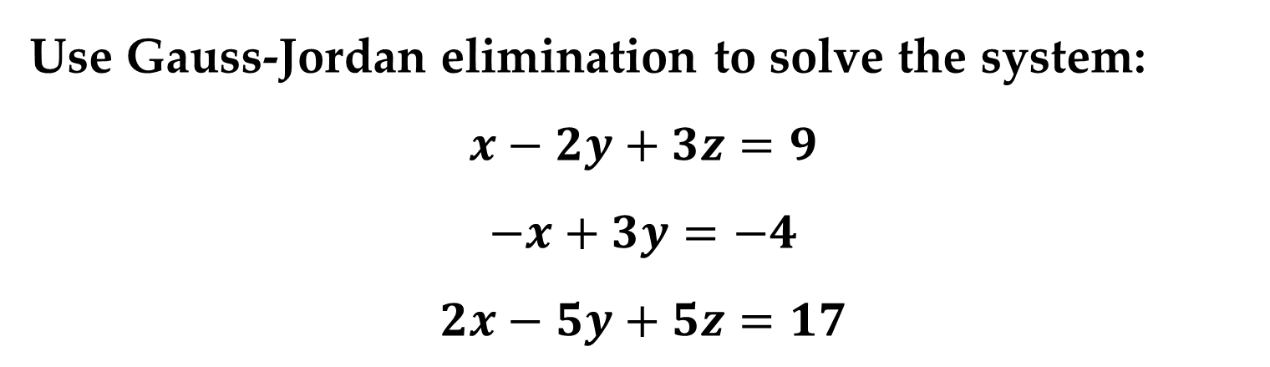
A second method of elimination, called Gauss-Jordan elimination after Carl Gauss (1777–1855) and Wilhelm Jordan (1842–1899), continues the reduction process until a reduced row-echelon form is obtained.
Example 7. Gauss-Jordan Elimination
Use Gauss-Jordan elimination to solve the system:
$$x−2y+3z=9$$
$$−x+3y=−4$$
$$2x−5y+5z=17$$
Gauss-Jordan Elimination

Slide 38
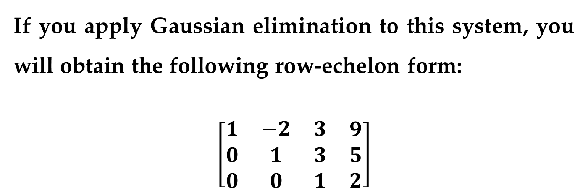
Solution (continued)
If you apply Gaussian elimination to this system, you will obtain the following row-echelon form:
$$\left[\begin{matrix}\begin{matrix}1 & −2 & 3 \\ 0 & 1 & 3 \\ 0 & 0 & 1\end{matrix} & \begin{matrix}9 \\ 5 \\ 2\end{matrix}\end{matrix}\right]$$
Now, rather than using back-substitution, apply elementary row operations until you obtain a matrix in reduced row-echelon form.
Gauss-Jordan Elimination

Slide 39
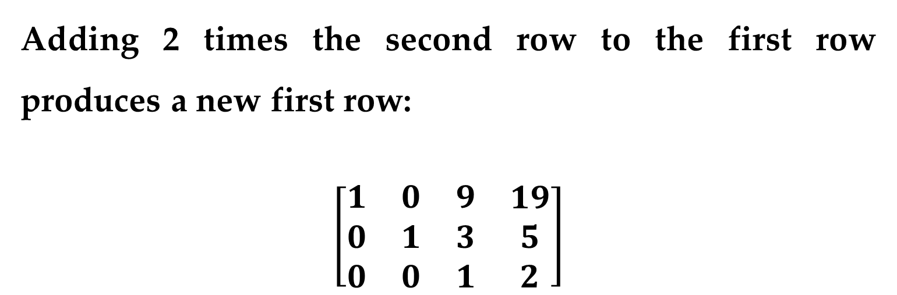
Solution (continued)
To do this, you must produce zeros above each of the leading 1’s, as follows.
Adding 2 times the second row to the first row produces a new first row:
$$\left[\begin{matrix}\begin{matrix}1 & 0 & 9 \\ 0 & 1 & 3 \\ 0 & 0 & 1\end{matrix} & \begin{matrix}19 \\ 5 \\ 2\end{matrix}\end{matrix}\right]$$
Gauss-Jordan Elimination

Slide 40
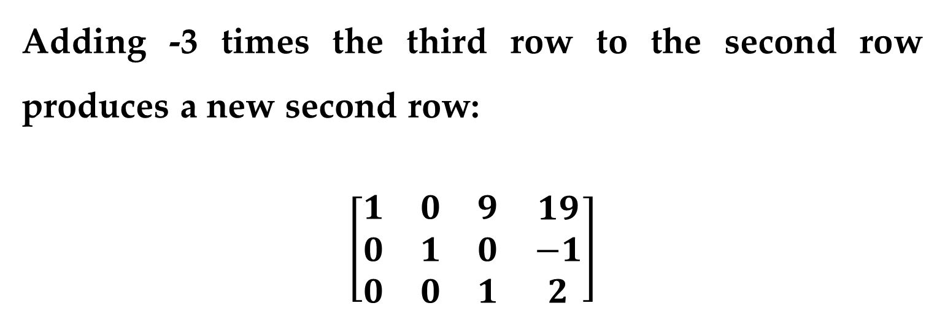
Solution (continued)
Adding -3 times the third row to the second row produces a new second row:
$$\left[\begin{matrix}\begin{matrix}1 & 0 & 9 \\ 0 & 1 & 0 \\ 0 & 0 & 1\end{matrix} & \begin{matrix}19 \\ −1 \\ 2\end{matrix}\end{matrix}\right]$$
Gauss-Jordan Elimination

Slide 41
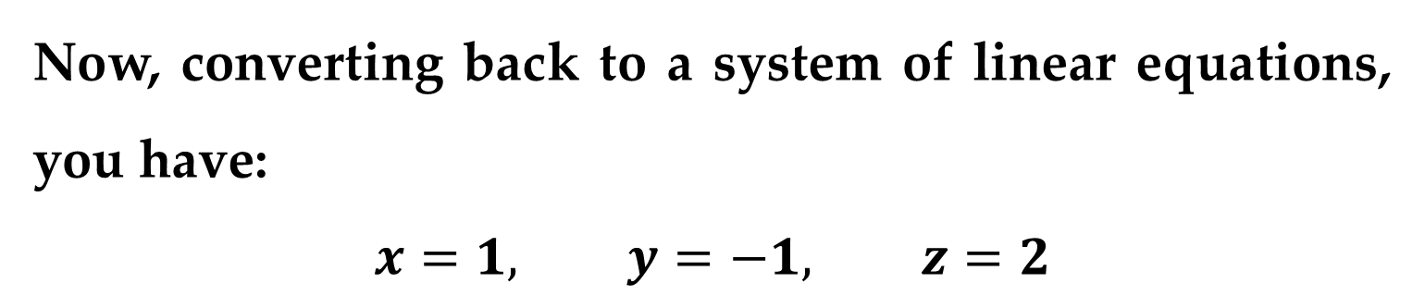
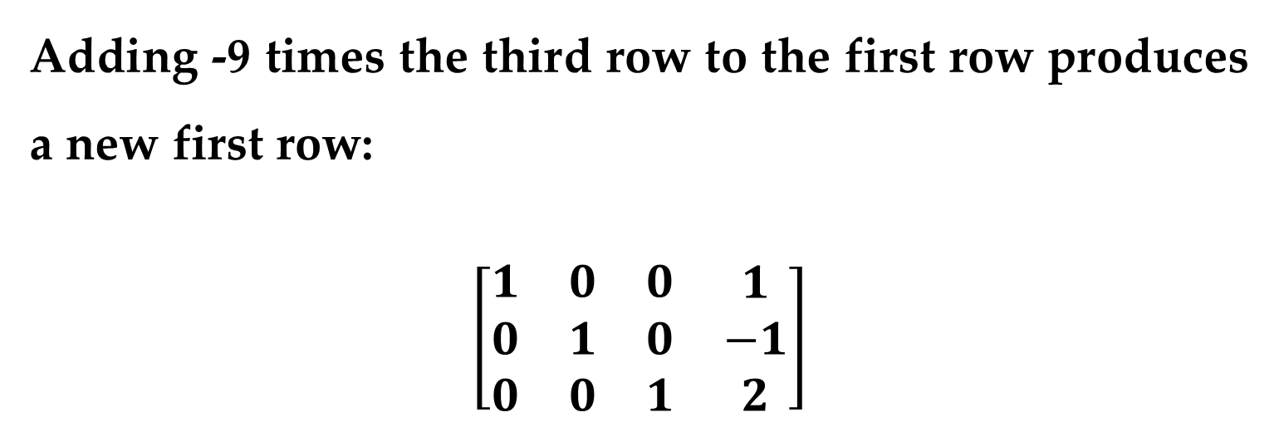
Solution (continued)
Adding -9 times the third row to the first row produces a new first row:
$$\left[\begin{matrix}\begin{matrix}1 & 0 & 0 \\ 0 & 1 & 0 \\ 0 & 0 & 1\end{matrix} & \begin{matrix}1 \\ −1 \\ 2\end{matrix}\end{matrix}\right]$$
Now, converting back to a system of linear equations, you have:
$$x=1, y=−1, z=2$$
Gauss-Jordan Elimination

Slide 42
Remark
Both the Gaussian and Gauss-Jordan elimination procedures employ an algorithmic approach easily adapted to computer use.
The next example demonstrates how Gauss-Jordan elimination can be used to solve a system with an infinite number of solutions.
Gauss-Jordan Elimination

Slide 43
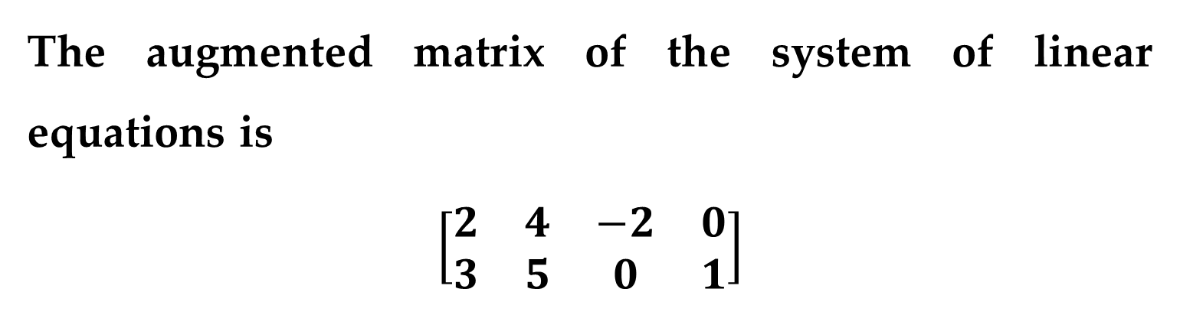
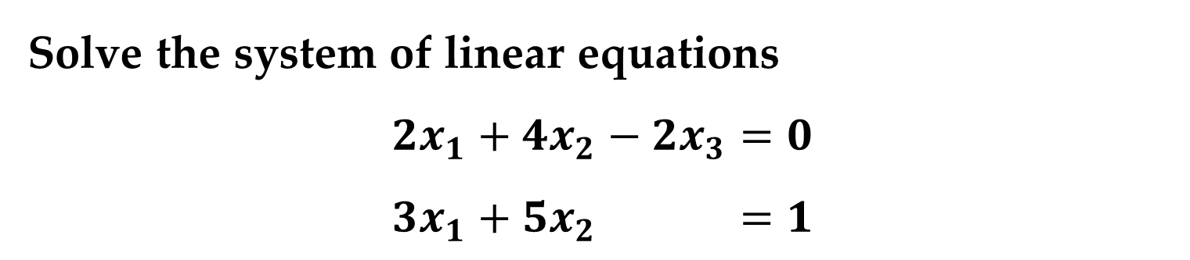
Example 8. A system with an Infinite Number of Solutions
Solve the system of linear equations
$$2x_{1}+4x_{2}−2x_{3}=0$$
$$3x_{1}+5x_{2} =1$$
Solution
The augmented matrix of the system of linear equations is
$$\left[\begin{matrix}\begin{matrix}2 & 4 & −2 \\ 3 & 5 & 0\end{matrix} & \begin{matrix}0 \\ 1\end{matrix}\end{matrix}\right]$$
Gauss-Jordan Elimination

Slide 44
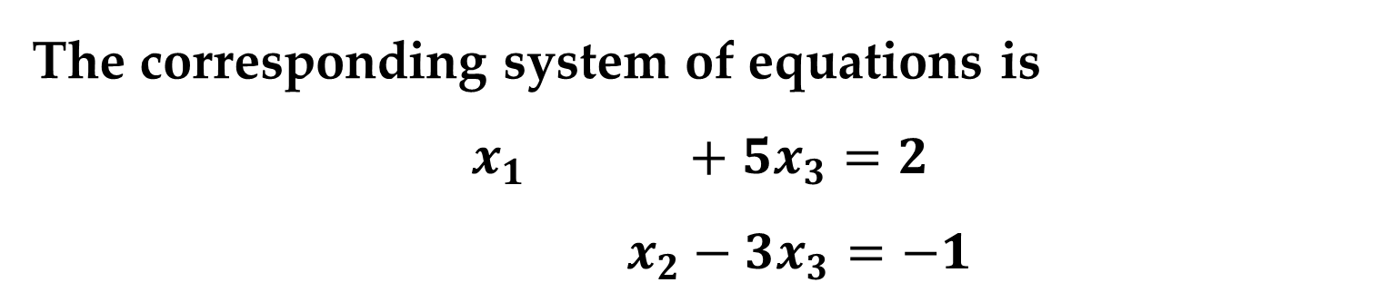

Solution (continued)
Using Gauss-Jordan elimination, you can verify that the reduced row-echelon form of the matrix is
$$\left[\begin{matrix}\begin{matrix}1 & 0 & 5 \\ 0 & 1 & −3\end{matrix} & \begin{matrix}2 \\ −1\end{matrix}\end{matrix}\right]$$
The corresponding system of equations is
$$x_{1} +5x_{3}=2$$
$$x_{2}−3x_{3}=−1$$
Gauss-Jordan Elimination

Slide 45

Solution (continued)
Now, using the parameter $t$ to represent the non-leading variable $x_{3}$, you have
$$x_{1}=2−5t, x_{2}=−1+3t, x_{3}=t$$
where $t$ is any real number.

Slide 46
You have looked at two elimination methods for solving a system of linear equations. Which is better?
To some degree the answer depends on personal preference.
In real-life applications of linear algebra, systems of linear equations are usually solved by computer.
Most computer programs use a form of Gaussian elimination, with special emphasis on ways to reduce rounding errors and minimize storage of data.
Which is Better?

Slide 47

Definition
Systems of linear equations in which each of the constant terms is zero are called homogeneous systems:
$$a_{11}x_{1}+a_{12}x_{2}+a_{13}x_{3}+…+a_{1n}x_{n}=0$$
$$a_{21}x_{1}+a_{22}x_{2}+a_{23}x_{3}+…+a_{2n}x_{n}=0$$
$$…………………………………………………..$$
$$a_{m1}x_{1}+a_{m2}x_{2}+a_{m3}x_{3}+…+a_{mn}x_{n}=0$$
Homogeneous Systems of Linear Equations

Slide 48
Remark
It is easy to see that a homogeneous system must have at least one solution.
Specifically, if all variables in a homogeneous system have the value zero, then each of the equations must be satisfied.
Such a solution is called trivial (or obvious).
Homogeneous Systems of Linear Equations

Slide 49


Example 9. Solving a Homogeneous System of Linear Equations
Solve the system of linear equations
$$x_{1}−x_{2}+3x_{3}=0$$
$${2x}_{1}+x_{2}+3x_{3}=0$$
Solution
Apply Gauss-Jordan elimination to the augmented matrix
$$\left[\begin{matrix}\begin{matrix}1 & −1 & 3 \\ 2 & 1 & 3\end{matrix} & \begin{matrix}0 \\ 0\end{matrix}\end{matrix}\right]$$
Homogeneous Systems of Linear Equations

Slide 50


Solution (continued)
We obtain the following modified matrix:
$$\left[\begin{matrix}\begin{matrix}1 & 0 & 2 \\ 0 & 1 & −1\end{matrix} & \begin{matrix}0 \\ 0\end{matrix}\end{matrix}\right]$$
The system of equations corresponding to this matrix is
$$x_{1}+2x_{3}=0$$
$$x_{2}−x_{3}=0$$
Homogeneous Systems of Linear Equations

Slide 51


Solution (continued)
Using the parameter $t=x_{3}$, the solution set is
$$x_{1}=−2t, x_{2}=t, x_{3}=t, t∈R$$
where $t$ is any real number.
This system of equations has an infinite number of solutions, one of which is the trivial solution (given $t=0$).
Homogeneous Systems of Linear Equations

Slide 52
Theorem 1. The Number of Solutions of a Homogeneous System
Every homogeneous system of linear equations is consistent.
Moreover, if the system has fewer equations than variables, then it must have an infinite number of solutions.

Slide 53
Thank You for Attention

